Slide 1
MACHINE LEARNING

Slide 2
Goodness Of Cluster

Slide 3
Every modeling technique requires an evaluation phase.
clustering models need to be evaluated as well. Some of the questions of interest might be the following:
Do my clusters actually correspond to reality, or are they simply artifacts of mathematical convenience?
I am not sure how many clusters there are in the data.
What is the optimal number of clusters to identify? How do I measure whether one set of clusters is preferable to another?
we introduce two methods for measuring cluster goodness, the silhouette method, and the pseudo-F statistic. These techniques will help to address these questions by evaluating and measuring the goodness of our cluster solutions.
Any measure of cluster goodness, or cluster quality, should address the concepts of cluster separation as well as cluster cohesion.
Cluster separation represents how distant the clusters are from each other;
cluster cohesion refers to how tightly related the records within the individual clusters are

Slide 4
For example:
It has been written elsewhere that the sum of squares error (SSE) is a good measure of cluster quality.
However, by measuring the distance between each record and its cluster center, SSE accounts only for cluster cohesion and does not account for cluster separation.
Thus, SSE is monotonically decreasing as the number of clusters increases, which is not a desired property of a valid measure of cluster goodness.
Of course, both the silhouette method and the pseudo-F statistic account for both cluster cohesion and cluster separation

Slide 5
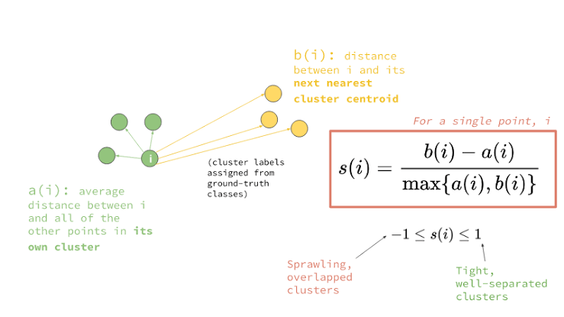
The Silhouette Method:
For each data value i,

Slide 6
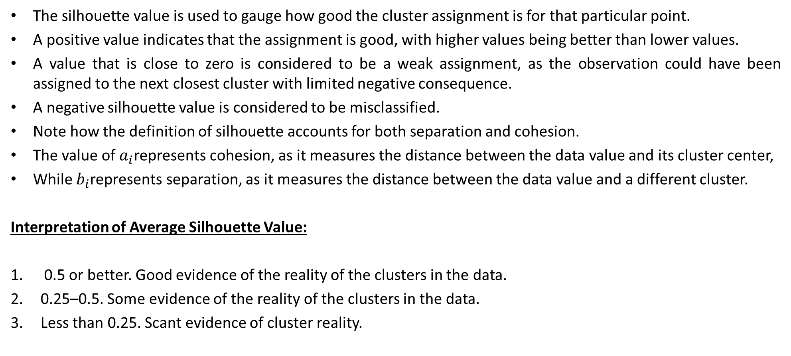
The silhouette value is used to gauge how good the cluster assignment is for that particular point.
A positive value indicates that the assignment is good, with higher values being better than lower values.
A value that is close to zero is considered to be a weak assignment, as the observation could have been assigned to the next closest cluster with limited negative consequence.
A negative silhouette value is considered to be misclassified.
Note how the definition of silhouette accounts for both separation and cohesion.
The value of $a_{i}$represents cohesion, as it measures the distance between the data value and its cluster center,
While $b_{i}$represents separation, as it measures the distance between the data value and a different cluster.
Interpretation of Average Silhouette Value:
0.5 or better. Good evidence of the reality of the clusters in the data.
0.25–0.5. Some evidence of the reality of the clusters in the data.
Less than 0.25. Scant evidence of cluster reality.

Slide 7
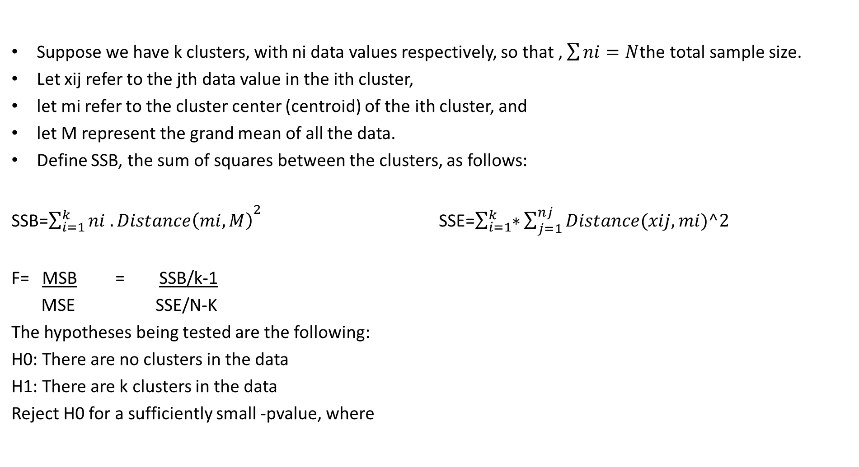
Pseudo F –Statistic:
Suppose we have k clusters, with ni data values respectively, so that , $\sum{ni=N}$the total sample size.
Let xij refer to the jth data value in the ith cluster,
let mi refer to the cluster center (centroid) of the ith cluster, and
let M represent the grand mean of all the data.
Define SSB, the sum of squares between the clusters, as follows:
SSB=${\sum_{i=1}^{k}{ni .Distance\left(mi,M\right)}}^{2}$SSE=$\sum_{i=1}^{k}{∗}\sum_{j=1}^{nj}{Distance(xij,mi)^2}$
F= MSB = SSB/k-1
MSE SSE/N-K
The hypotheses being tested are the following:
H0: There are no clusters in the data
H1: There are k clusters in the data
Reject H0 for a sufficiently small -pvalue, where

Slide 8
Omkar N

